Slide 1

Math APP
Your Personal Math Assistant
CS691
July 2024
Educators-Assembled

Slide 2
Agenda
01
02
03
04
05
Sprint 2 Recap
Team Member Names
Roles & Responsibilities
Improvements
Team Working Agreement
Project Overview
Problem Statement
Project Description
MVP
Languages & tools
Diagrams
Backlogs
Product Backlogs
Sprint 2 Backlogs
Test Cases
Acceptance Criteria
Team Metrics
Team Velocity
Burndown Charts
Retrospective
Product
Sprint 3 Stories
Application Screenshots
Live Demo
Notes:
Olivia

Slide 3



Our Team
Olivia Arroyo
Xiaofeng Leng
Product Owner/ Developer
Developer
Amélie Obas
Scrum Master
Notes:
Xiaofeng

Slide 4
Improvements
Targeted Group Feedback for Retrospective
Overlayed Metrics
MVP Completion
Application Home Page
Application Dashboard
Application Student Progress Page
Notes:
Olivia

Slide 5
Problem Statement
Currently there apps are widely available that allow students to scan their Math homework problems and instantly receive answers to those exams. However, providing a student with an answer on a homework problem does not help the student learn how to solve that problem and can lead to a learned helplessness.
These applications are frowned upon in the educational setting because they don’t provide students with the tools they need to learn- no one learns from receiving the answer and not working through the problem.
Students often hide that they are using these apps since they don’t want to admit that they are struggling and using them could also be considered cheating. If these applications were modified, they could provide students with a richer learning experience and be a tool to push students through the productive struggle.
Notes:
Amélie

Slide 6
Project Description
A web app that helps students tackle math problems effectively and offers educators insights into student growth and struggles.
Identifies math problem topics through real-time text classification and provides step-by-step instructions, model problems, and interactive tutorials.
Caters to students needing resources relevant to their current learning and educators aiming to gauge student understanding and mastery of the material.
Utilizes advanced image recognition to offer instant, detailed assistance, making math learning more accessible and less frustrating.
Supports teachers and tutors with responsive pedagogical tool to better assist students and their homework needs.
Notes:
Amélie

Slide 7
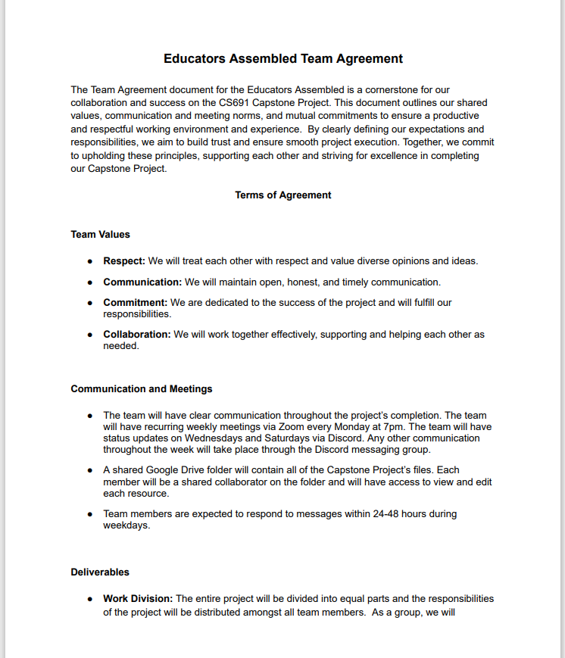
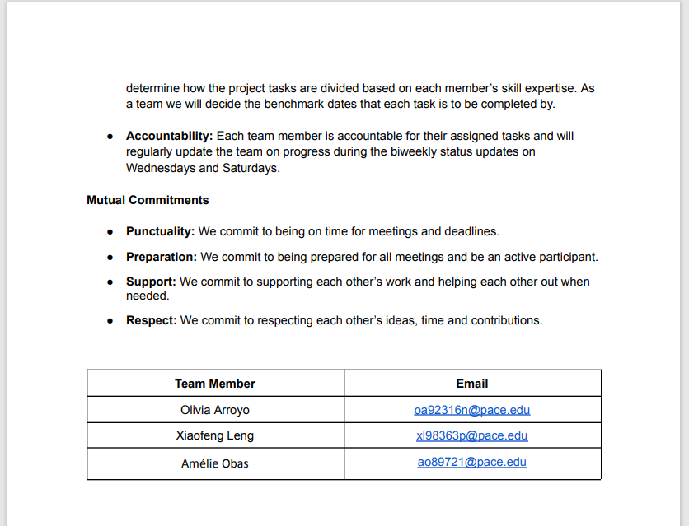
Team Agreement
Notes:
Olivia

Slide 8
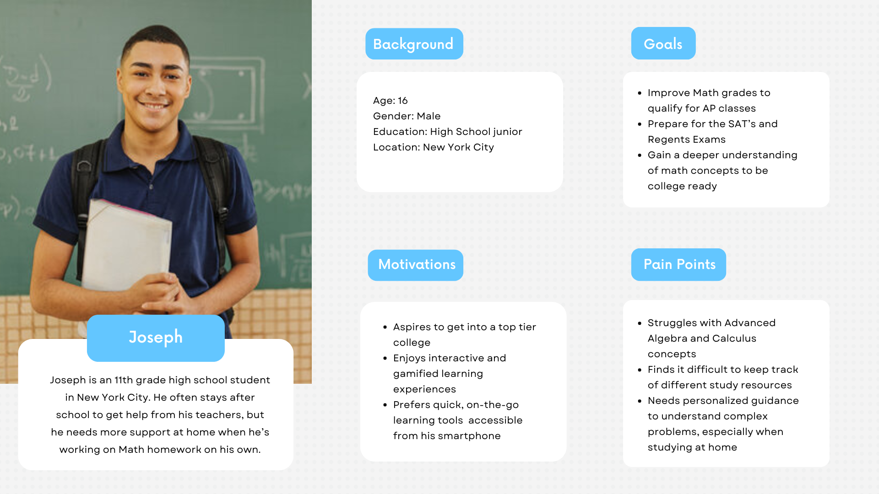
User Persona: Student
Notes:
Olivia

Slide 9
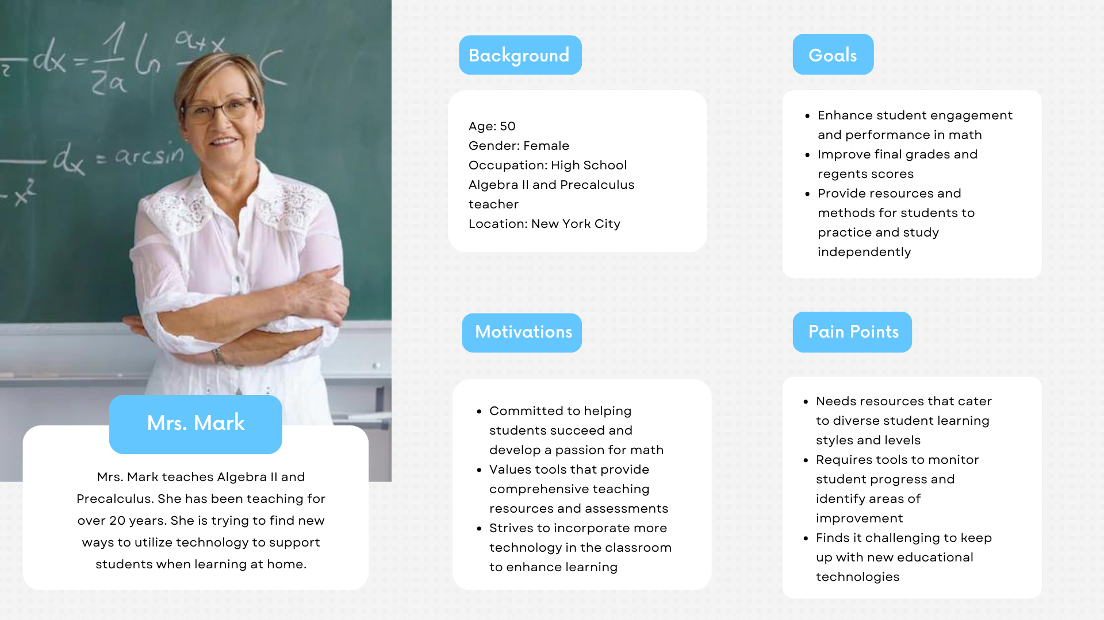
User Persona: Teacher
Notes:
Olivia

Slide 10
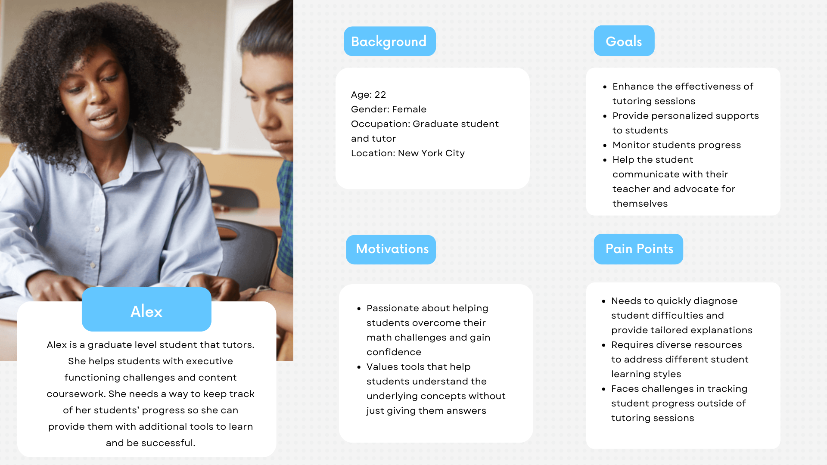
User Persona: Tutor
Notes:
Olivia

Slide 11
Minimal Viable Product
Problem Input: Implement an input system for users to write their math problems directly into the app.
User Interaction: The teacher can reply to or comment on the questions posed by the student.
User Interface: Design a simple and intuitive user interface to facilitate easy navigation and interaction with the app.
Testing and Debugging: Conduct thorough testing and debugging to ensure the functionality and reliability of the app on different Android devices.
Notes:
Xiaofeng

Slide 12










Languages & Tools
Figma
Android Studio
Java
Python
TensorflowLite
GitHub
Android Jetpack
Notes:
Xiaofeng

Slide 13
Conceptual Architecture Diagram
Client User Interface: XML
Python Machine Learning Model
Tensorflow & Keras
Java Backend
Machine Learning Database
Notes:
Olivia

Slide 14
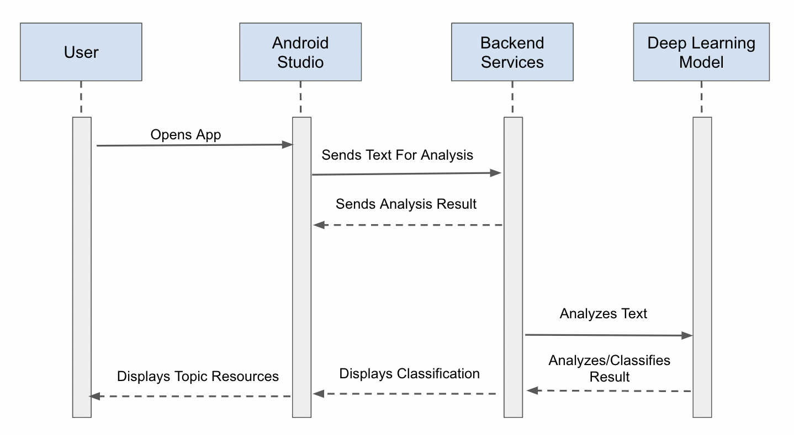
Sequence Diagram
Notes:
Olivia

Slide 15
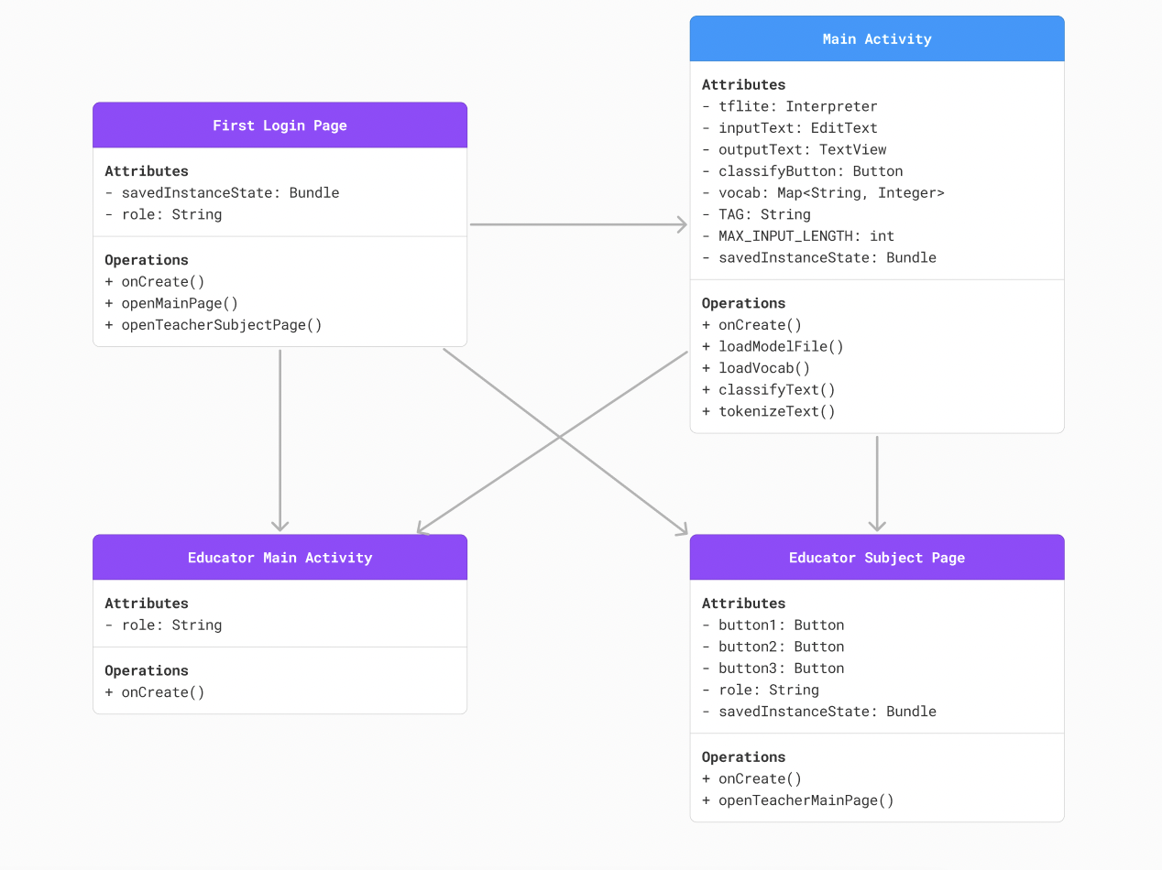
Class
Diagram
Notes:
Olivia

Slide 16
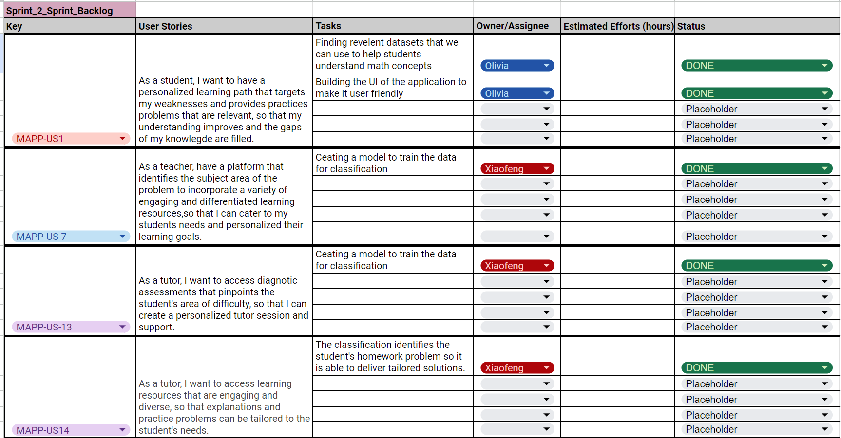
Sprint 2 Recap
Notes:
Amélie

Slide 17
Sprint 2 Recap
S2
S3
Model Training
Trained and tuned the model to increase the accuracy of prediction
Student User Login Page
Page with a navigation button labeled student
Classification Page
Student enter math word problem and the app determines the math course level
MVP Completion
Able to capture and categorize word problems, offers related learning materials, and tracks student performance.
Home Page
Page with 2 navigation buttons labeled student (user), teacher(educator, includes tutor)
MAPP Dashboard Page
Math problems entered are classified by math course level and related resources are displayed
Student Progress Page
Student can view comments and/or feedback from teacher/tutor. Can view the history problem list and can set it to complete.
Notes:
Amélie

Slide 18
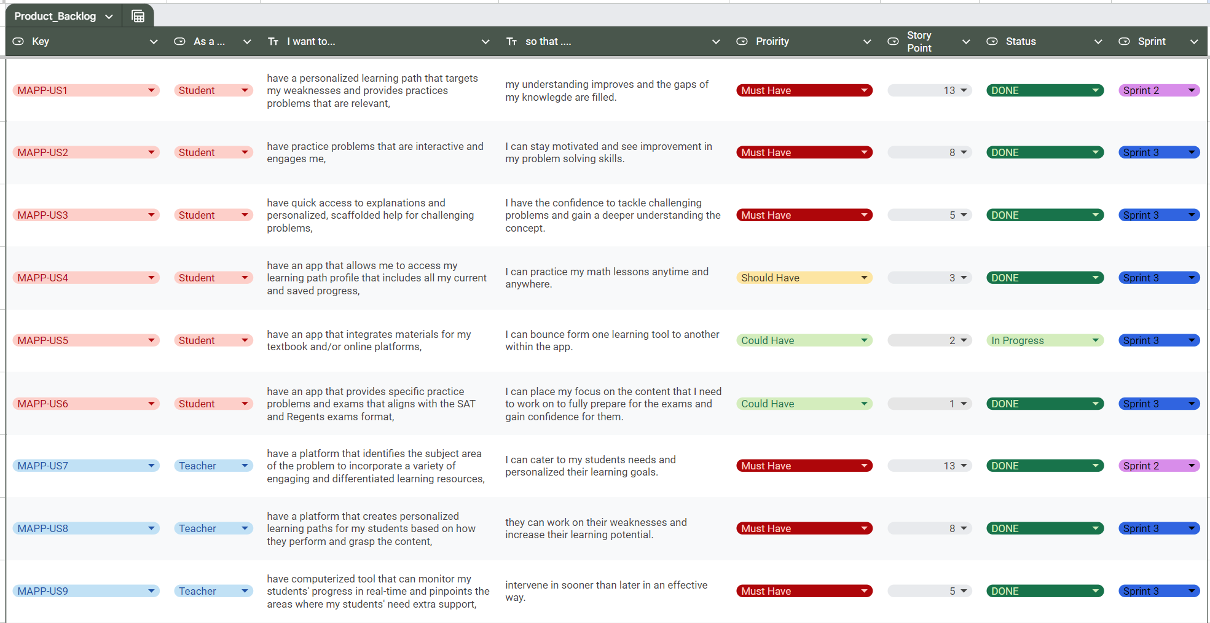
Product Backlog
Notes:
Amélie

Slide 19
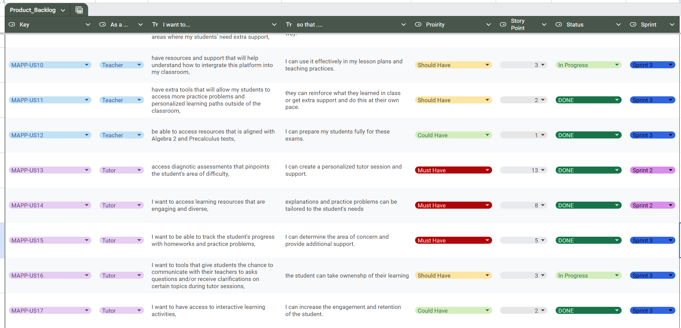
Product Backlog
Notes:
Amélie

Slide 20
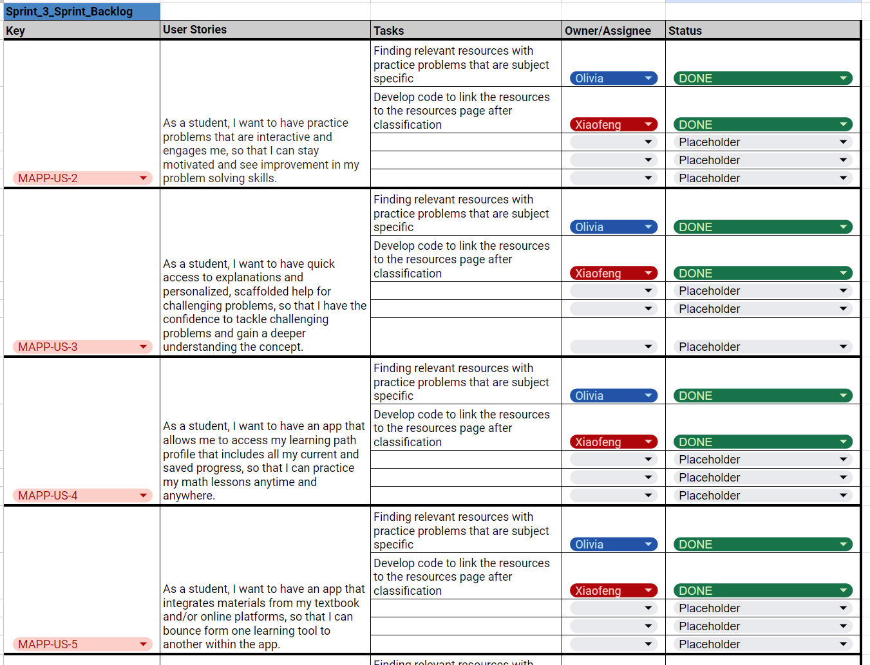
Sprint 3 Backlog
Notes:
Amélie

Slide 21
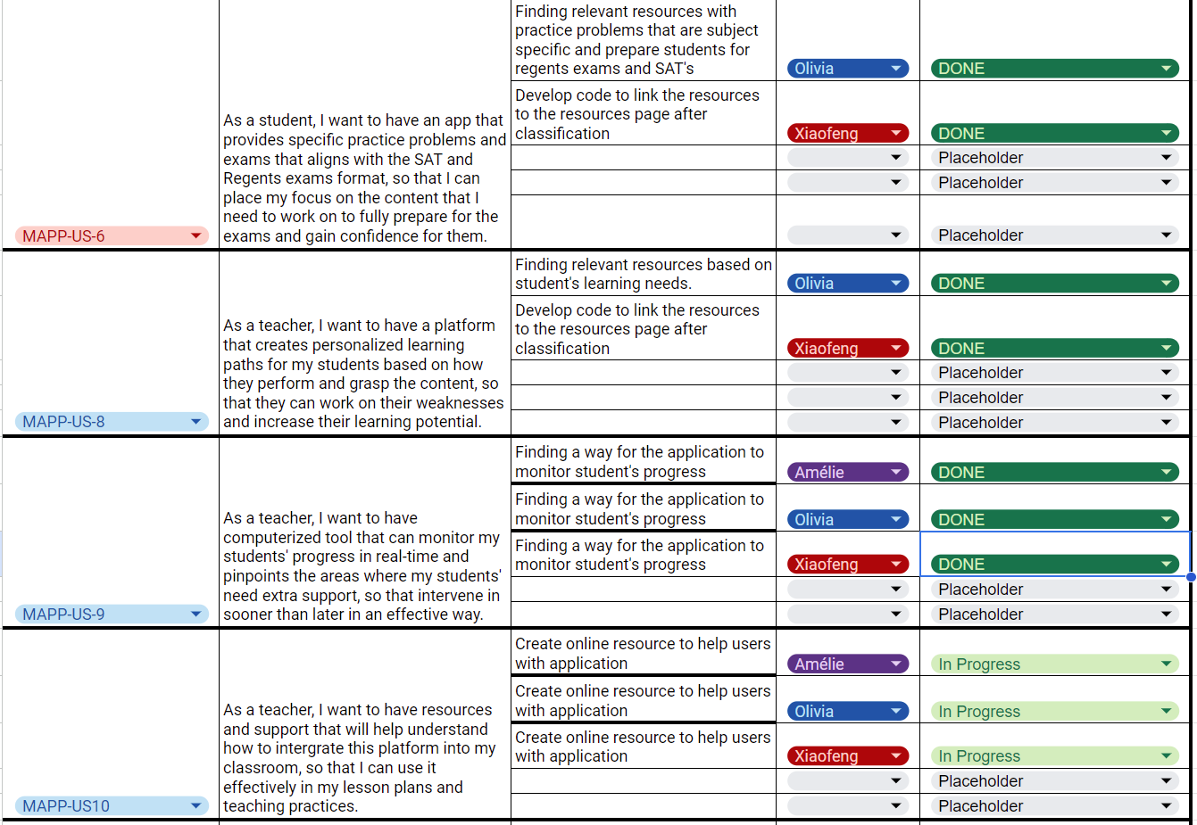
Sprint 3 Backlog
Notes:
Amélie

Slide 22
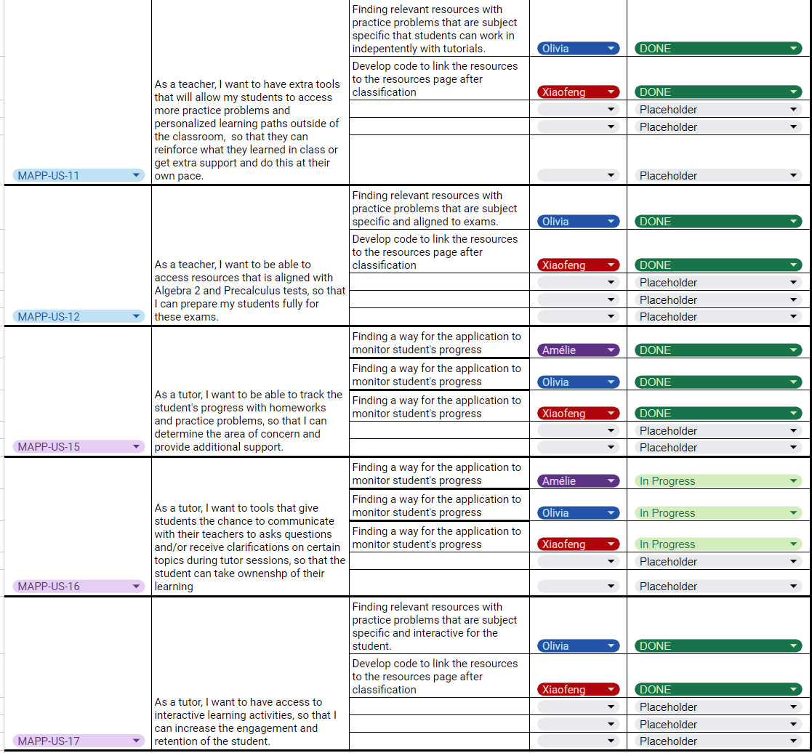
Sprint 3 Backlog
Notes:
Amélie

Slide 23
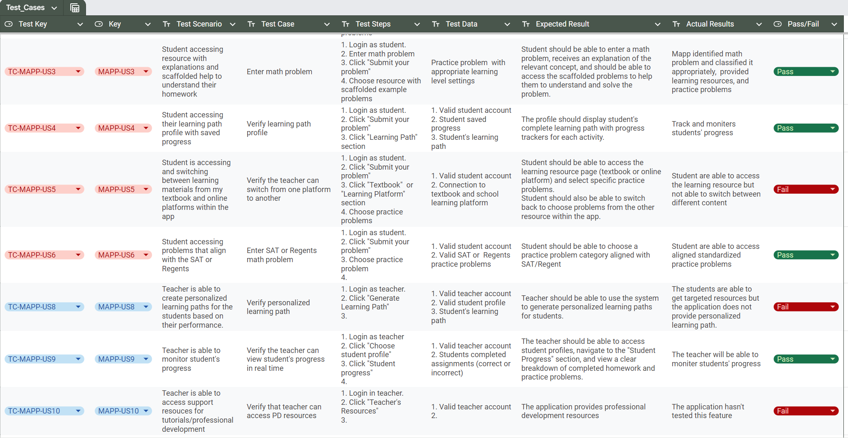
Test Cases
Notes:
Amélie

Slide 24
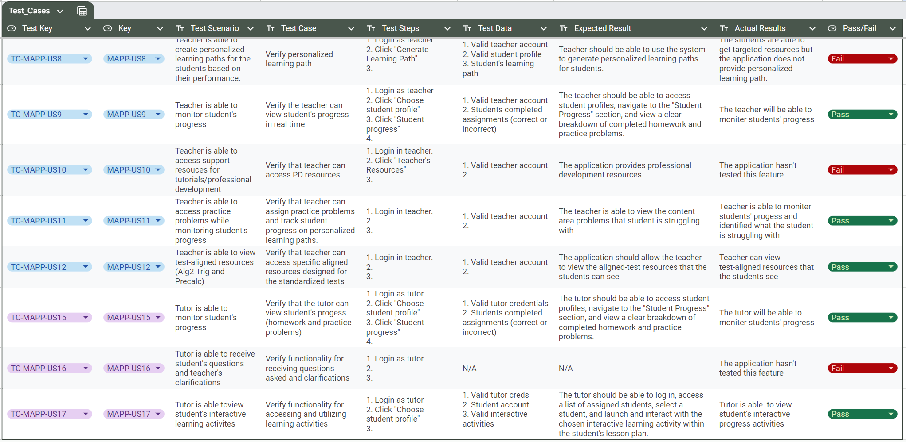
Test Cases
Notes:
Amélie

Slide 25
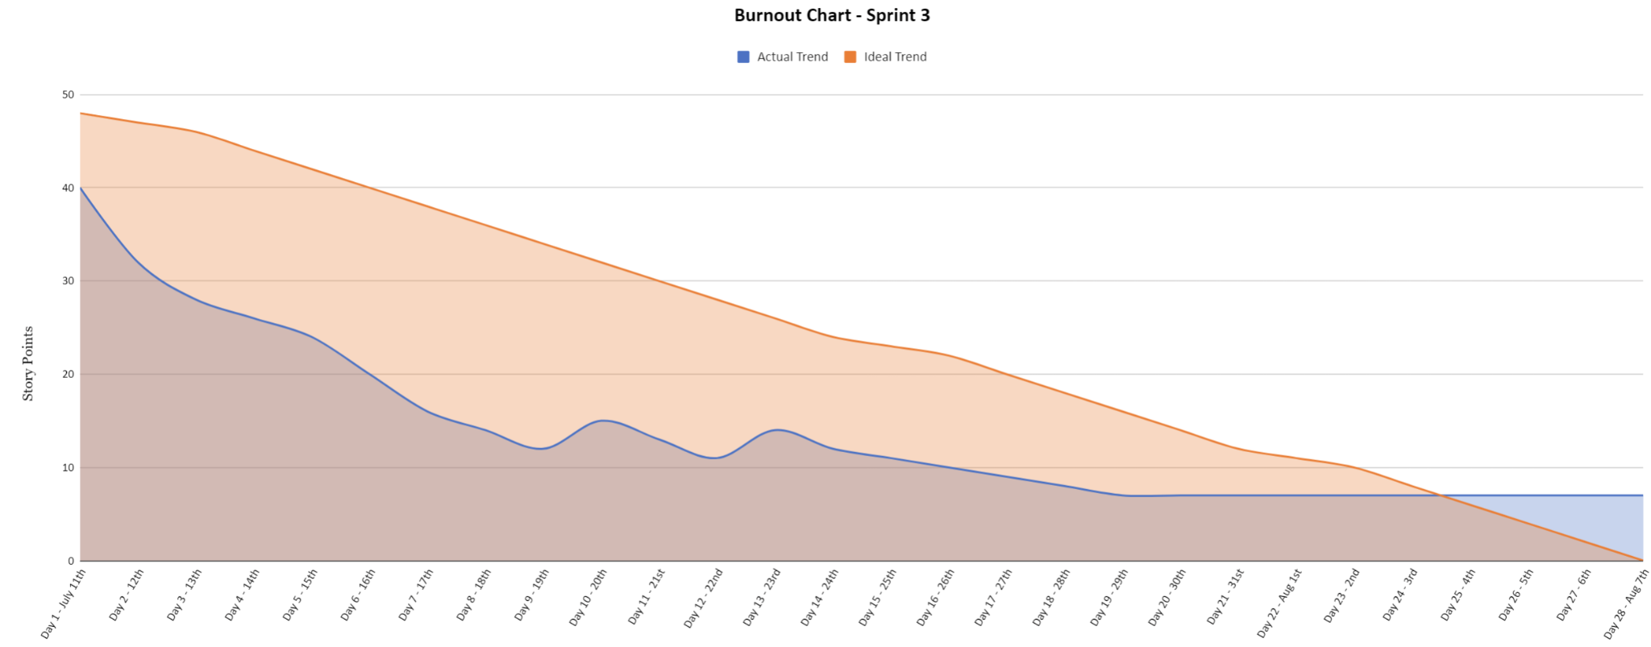
Metrics
Notes:
Amélie

Slide 26
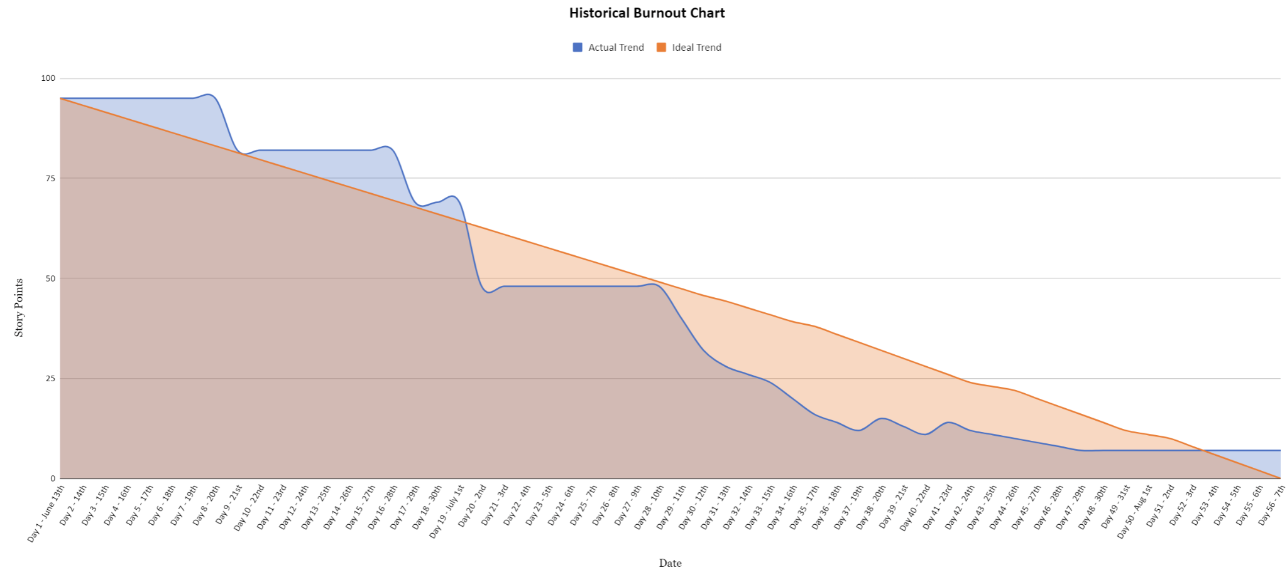
Metrics
Notes:
Amélie

Slide 27
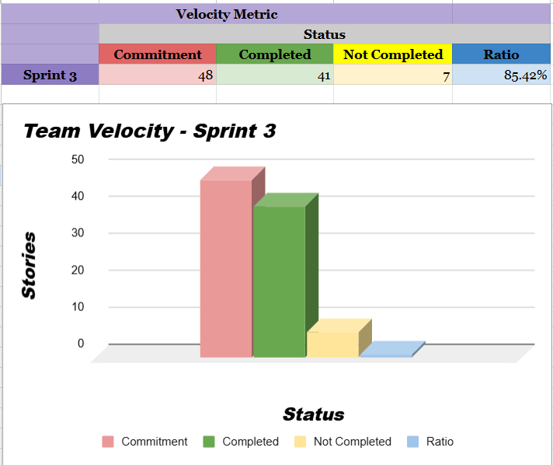
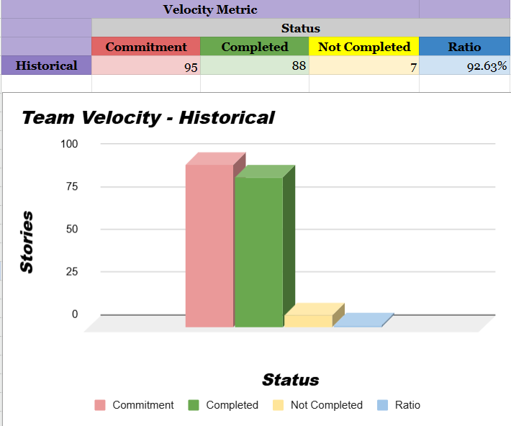
Metrics
Notes:
Amélie

Slide 28
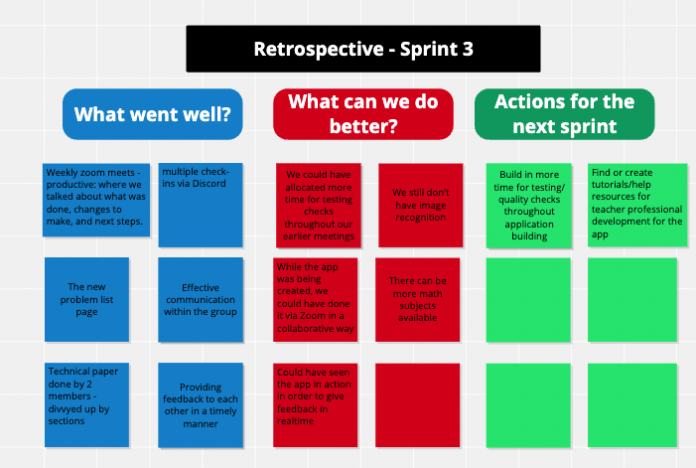
Retrospective
Notes:
Olivia

Slide 29
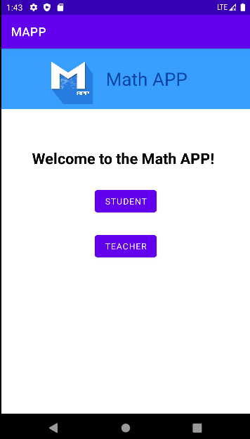
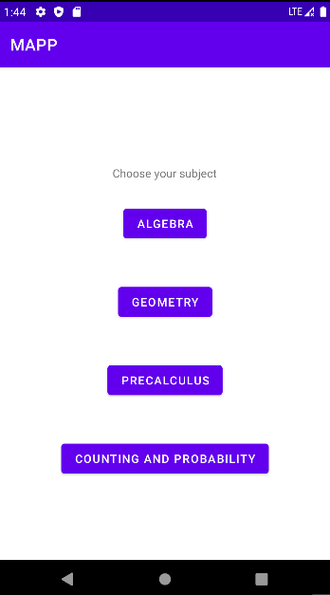
Application Screenshots - Login Page
Notes:
Xiaofeng

Slide 30
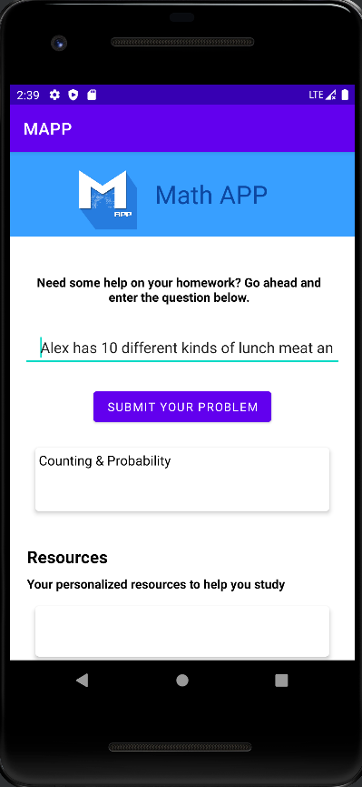
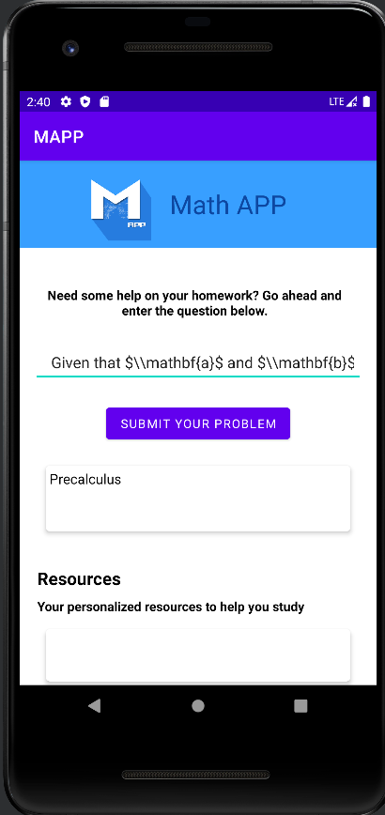
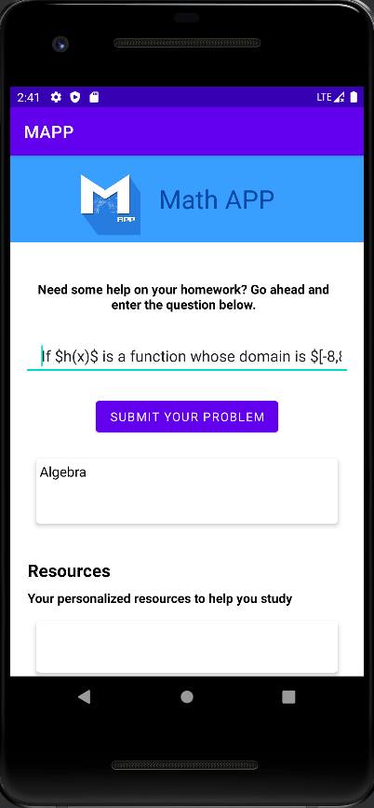
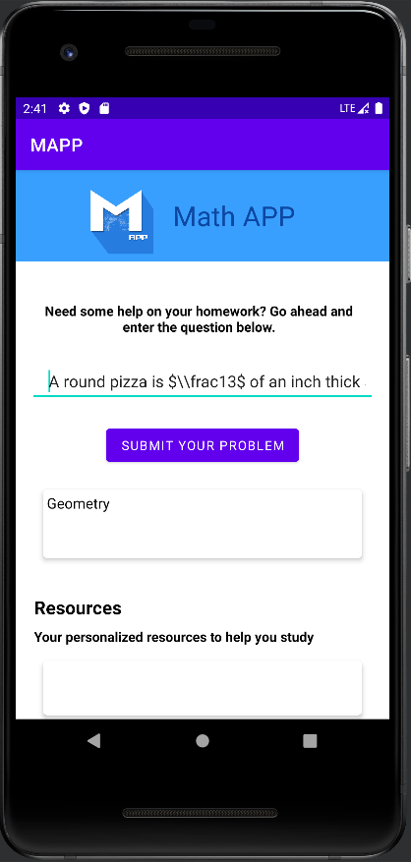
Application Screenshots- Classification
Notes:
Xiaofeng

Slide 31
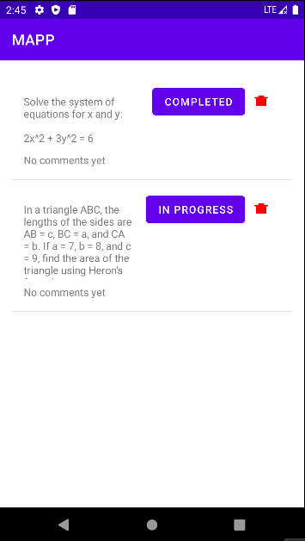
Application Screenshots- Problem List
Notes:
Xiaofeng

Slide 32
Live Project Demo
We will now present a live demo of our application.
Notes:
Xiaofeng

Slide 33
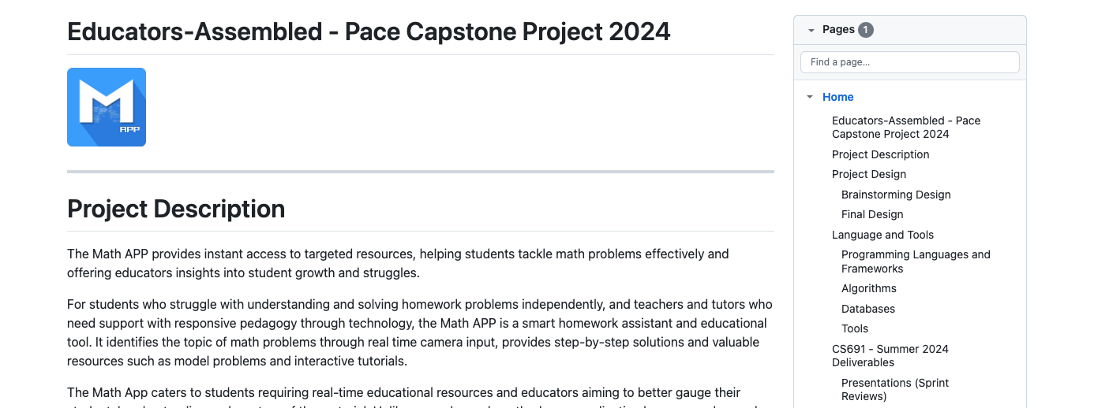
Wiki Page Link
https://github.com/htmw/Educators-Assembled/wiki
Notes:
Olivia

